Slide 2
Mahout Workshop, Section 7
Allen Day, PhD
MapR Technologies

Slide 3
Section 7 (this one)

Slide 4
Co-Occurrences

Slide 6
Statistically Interesting Phrases

Slide 8
Mahout Workshop, Section 8
Allen Day, PhD
MapR Technologies

Slide 9
Section 7 (this one)

Slide 10
Recommendation Systems

Slide 11
“All media will be personalized in 3 to 5 years”
Cheryl Sandberg, Facebook COO, 2010

Slide 12
Examples

Slide 13
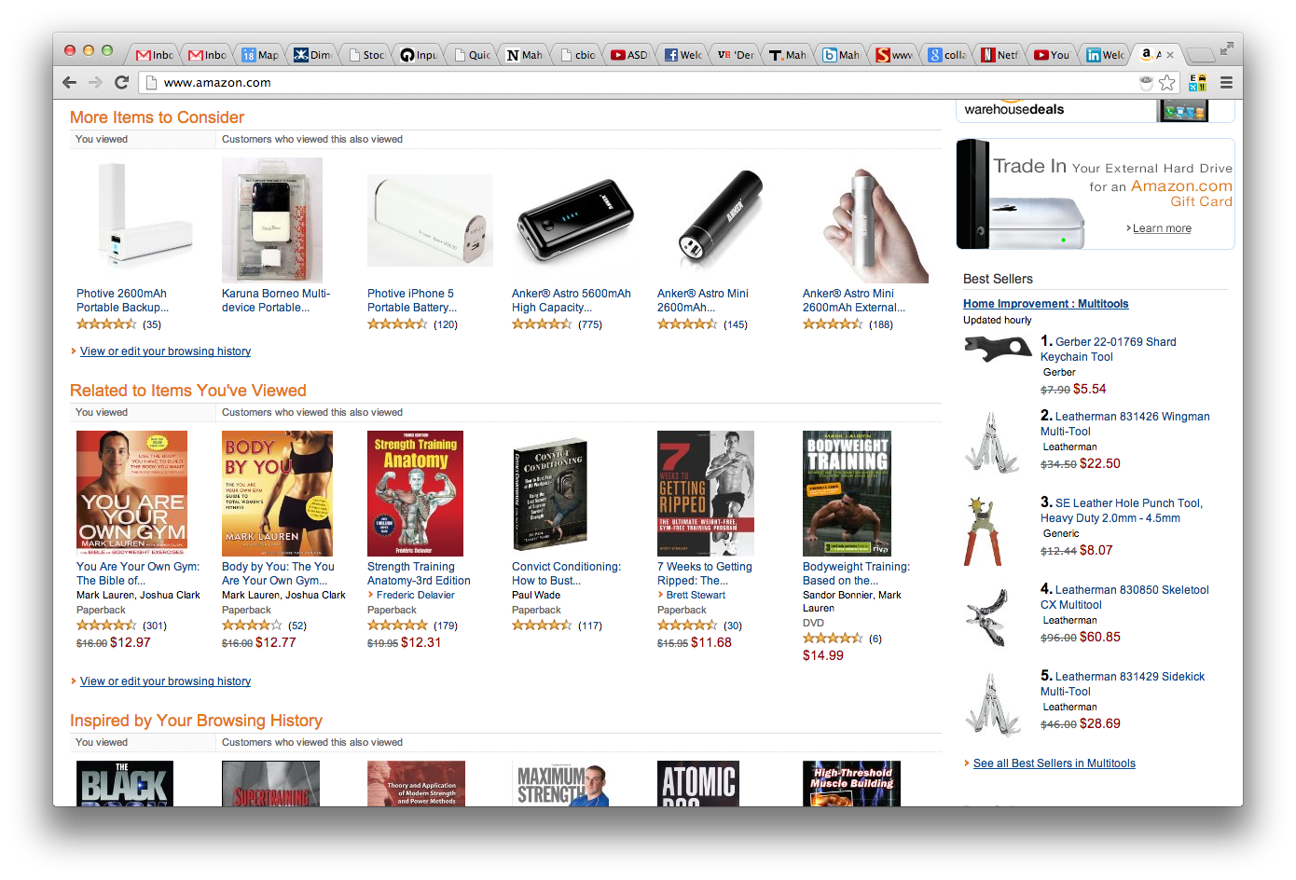

Slide 14
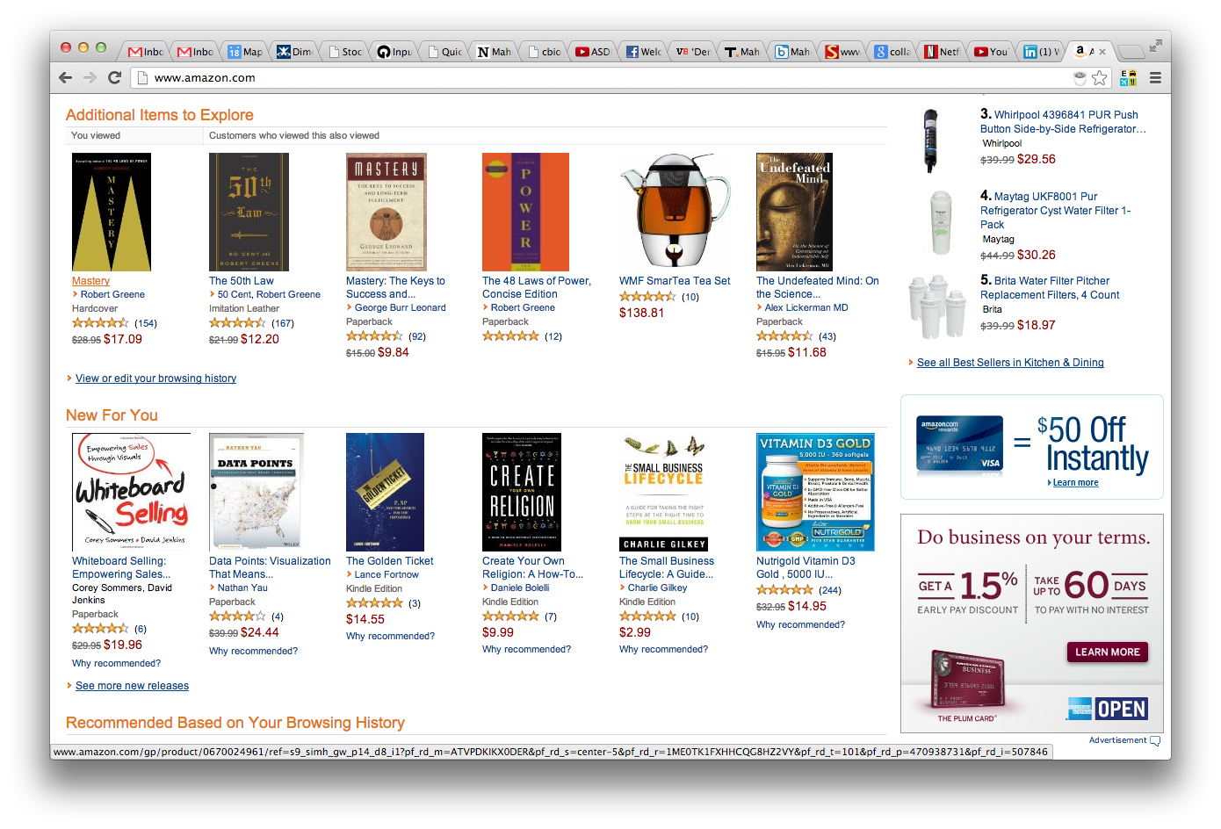

Slide 15
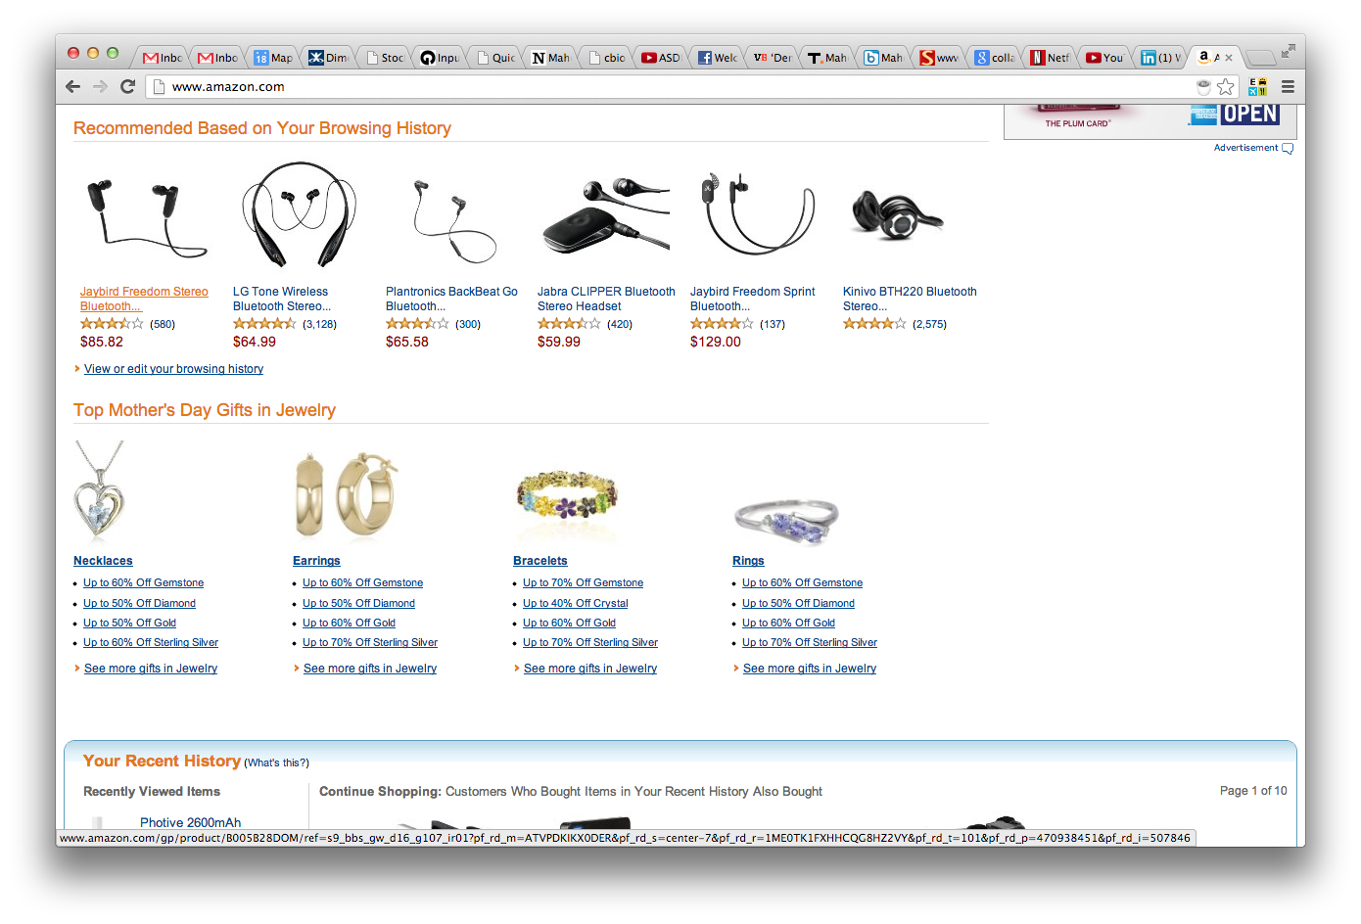

Slide 16
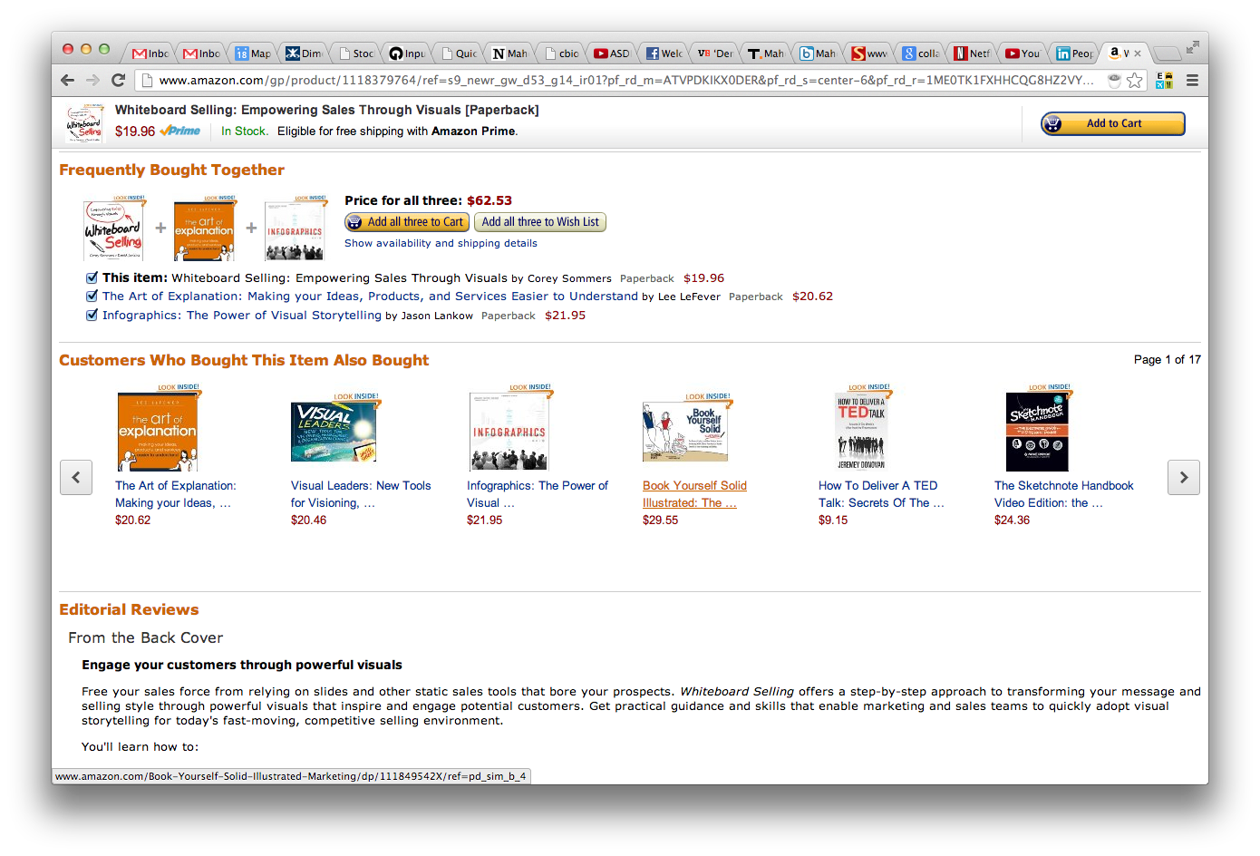

Slide 17
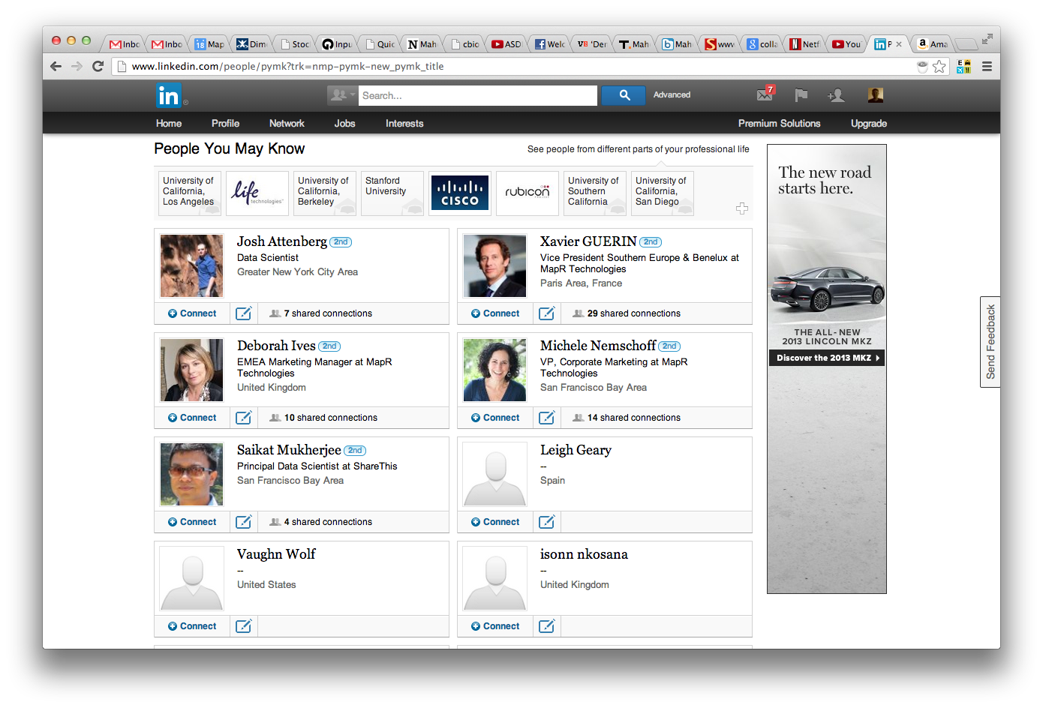

Slide 18
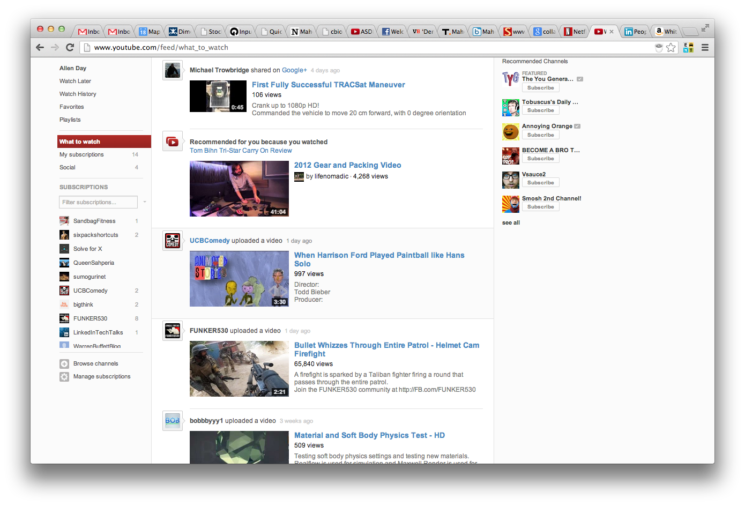

Slide 19
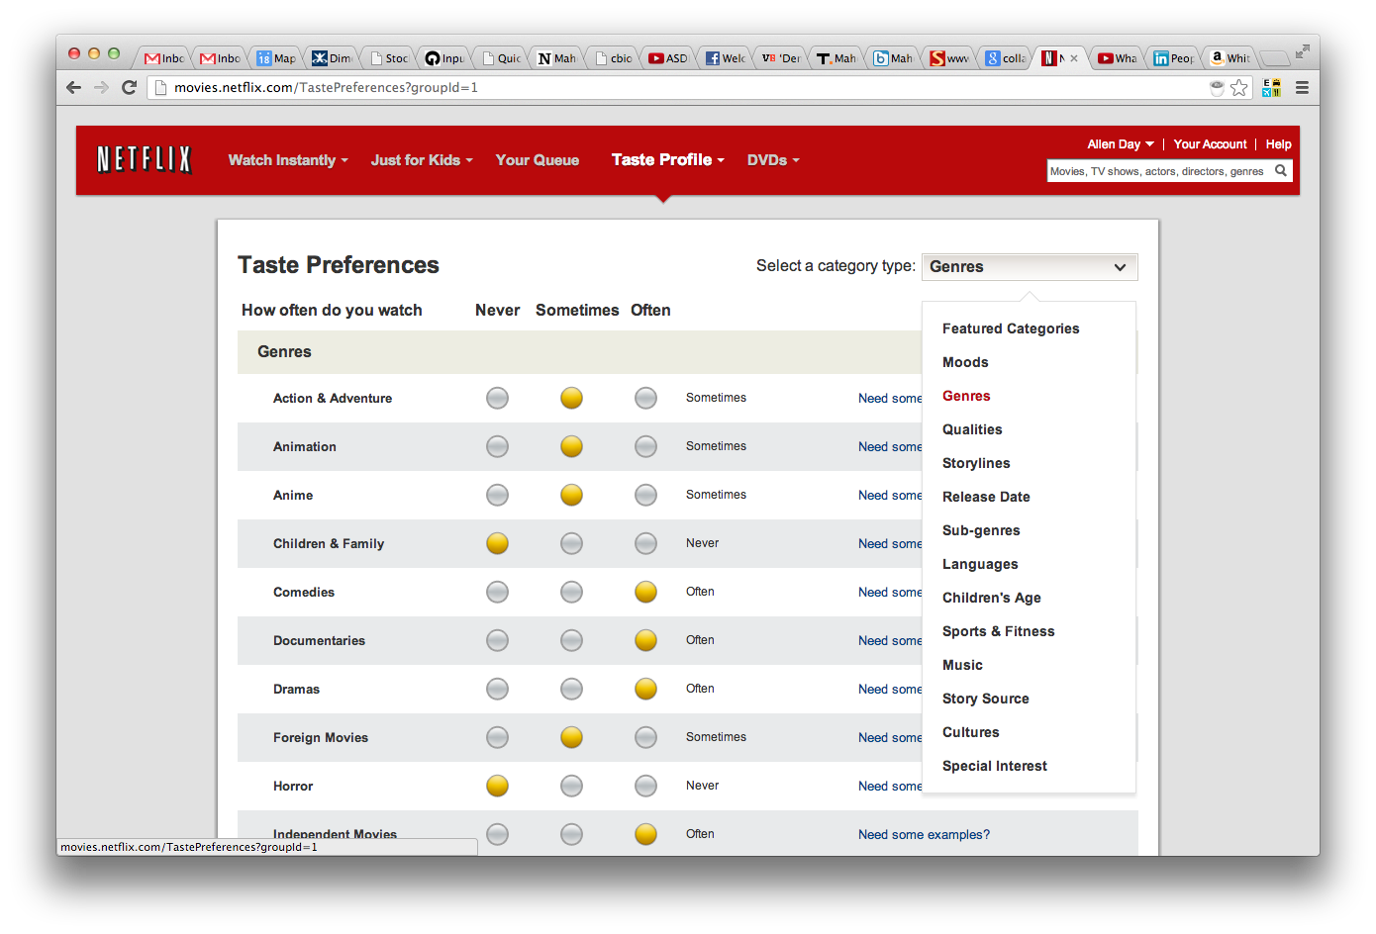

Slide 20
Parts List
Model
Vector model of data
M rows of users
N columns of items
These are examples, could also be:
M rows of men vs. N columns of women
M rows of users vs. N columns of… restaurants, docs

Slide 21
Recommendation Basics
History:
User | Thing
1 | 3
2 | 4
3 | 4
2 | 3
3 | 2
1 | 1
2 | 1
Also, event times

Slide 22
Recommendation Basics
History as matrix:
t1+t2 cooccur 2 times, t1+t4 once, t2+t4 once
 | t1 | t2 | t3 | t4
u1 | 1 | 0 | 1 | 0
u2 | 1 | 0 | 1 | 1
u3 | 0 | 1 | 0 | 1

Slide 23
Recommendation Basics
Coocurrence
 | t1 | t2 | t3 | t4
t1 | 2 | 0 | 2 | 1
t2 | 0 | 1 | 0 | 1
t3 | 2 | 0 | 1 | 1
t4 | 1 | 1 | 1 | 2
 | t3 | not t3
t1 | 2 | 1
not t1 | 1 | 1

Slide 24
Problems with Raw Cooccurrence
Very popular items co-occur with everything
Welcome document
Elevator music
That isn’t interesting
We want anomalous cooccurrence

Slide 25
Spot the Anomaly
Root LLR is roughly like standard deviations
 | A | not A
B | 13 | 1000
not B | 1000 | 100,000
 | A | not A
B | 1 | 0
not B | 0 | 2
0.44
0.98
 | A | not A
B | 1 | 0
not B | 0 | 10,000
 | A | not A
B | 10 | 0
not B | 0 | 100,000
2.26
7.15

Slide 26
Root LLR Details
In R
entropy = function(k) {
-sum(k*log((k==0)+(k/sum(k))))
}
llr = function(k) {
(entropy(rowSums(k))+entropy(colSums(k))
-entropy(k))/2
}
Like mutual information * N/2

Slide 27
Decomposition for Cooccurrence
Can use SVD for cooccurrence
But first one or two singular vectors just encode popularity … ignore those
V^{T} projects items into concept space, V projects back into item space
***SVD allows co-occurrence calculation in the absence of large data set

Slide 28
Cross Occurrence
We don’t have to do co-occurrence
We can do cross-occurrence
Result is cross-recommendation

Slide 29
Parts List

Slide 30
Parts List
Recall: Incidence matrix “A”
Adjacency Matrices
Row adjacency matrix (A^{T}*A)
M*M, symmetric about the diagonal y=x
Column adjacency matrix (A*A^{T})
N*N, symmetric about the diagonal y=x
Calculated using distance metric
d(m₁,m₂)
d(n₁,n₂)
Full dense calculation, O(n²) and O(m²)
Can we do better?

Slide 31
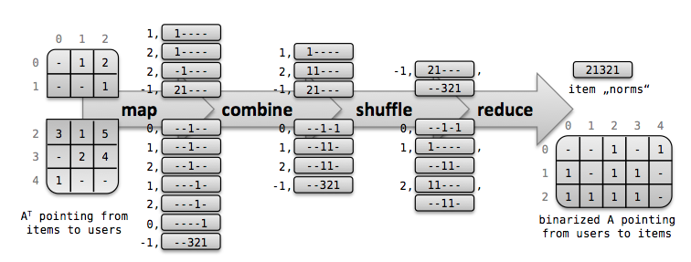
Applications
Recommendations for:
Items, to users (consumer perspective)
Users, to items (marketing perspective)
Users, to users (social perspective)
Items, to items (buyer and ops perspective)
“Scalable Neighborhood-Based Collaborative Filtering”, Schelter, et al.

Slide 32
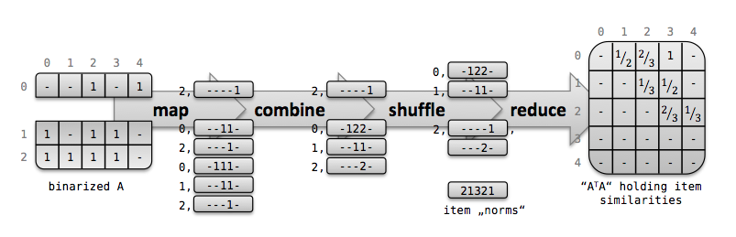
Applications
Recommendations for:
Items, to users (consumer perspective)
Users, to items (marketing perspective)
Users, to users (social perspective)
Items, to items (buyer and ops perspective)
“Scalable Neighborhood-Based Collaborative Filtering”, Schelter, et al.

Slide 33
Parts List
Analyzer
Cutoffs
Similarity (Distance) Metrics, as usual
May produce more models
May join/merge models

Slide 34
Cross Occurrence
We don’t have to do co-occurrence
row/row(A^{T}*A)
col/col (A*A^{T})
We can do cross-occurrence
row/row(A^{T}*B)
col/col (A*B^{T})
Result is cross-recommendation

Slide 35
Model can be Sub-composed
Details, model
Cross-recommendation
“Recommend” (predict) variables across domains
Here, predict income from social network
A
B

Slide 36
Mahout
MatrixMultiplicationJob for raw A’B multiplication
RowSimilarityJob
numberOfColumns
similarityClassname [use SIMILARITY_LOGLIKELIHOOD]
maxSimilaritiesPerRow [100]

Slide 37
Model Neighborhoods
K-Nearest Neighbor
Finding Similar Objects
Need:
Distance metric
Algorithm
Choose Neighbors
Info. transfer logic
c2
c1
c3

Slide 38
Co-Occurrence
Event Processing
Marginals, Summary Stats
Overall frequency of event occurrence
Indicates significance of an event in the log
Derivative data, e.g. “trending”
Can be used to improve signal/noise in model
Remove un-useful dimensions

Slide 39
User History
Search + Recommender
Tweakable
Most Popular Items – skew toward preferences
Personalized recommendations – skew toward most popular
History transforms
Full
Last N actions (of type “A”)
Time-based cutoff
Kernels

Slide 40
Rank Derivative, Details
Event Processing
Marginals, Summary Stats
R_{i,now} ≈ c*kª
Ri

Slide 41
Parts List
Model
Vector model of data
M rows of users
N columns of items
These are examples, could also be:
M rows of men vs. N columns of women
M rows of users vs. N columns of… restaurants, docs

Slide 42

SolR
Indexer
Cooccurrence
(Mahout)
SolR
Indexer
Complete history
Solr
indexing
Item meta-data
Index
shards

Slide 43
SolR
Indexer
Web tier
SolR
Indexer
Solr
search
User history
Item meta-data
Index
shards

Slide 44
Recommender + Search
Encoding features for search
SOLR document fields
Boosting
Idea: use non-doc features for improving precision/recall in search
Hidden from User

Slide 45
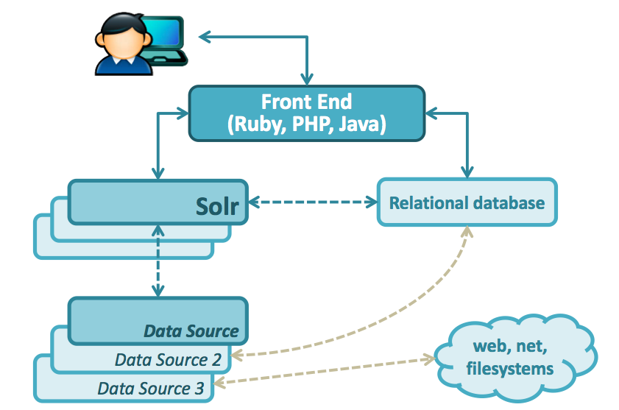

Slide 46
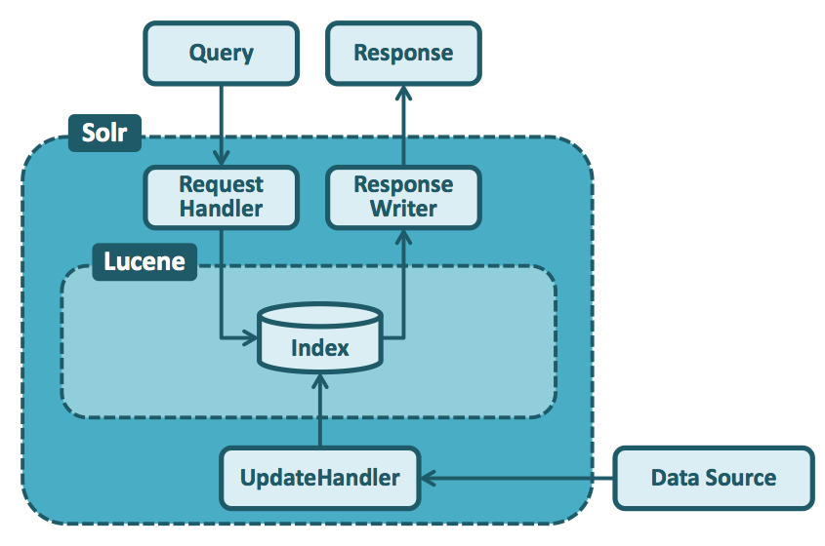

Slide 47
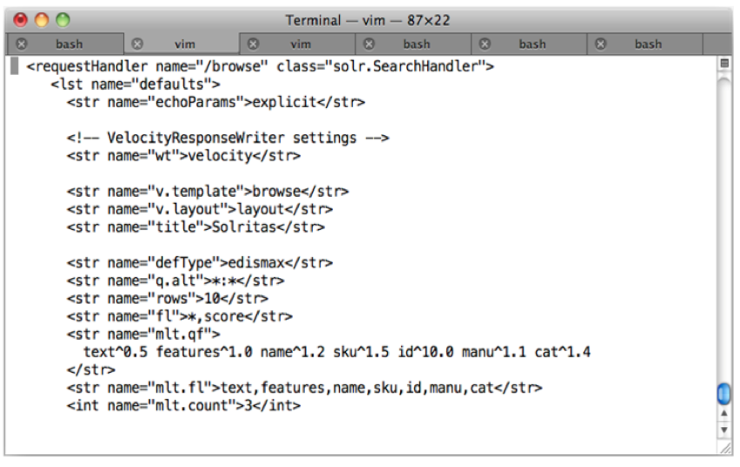

Slide 48
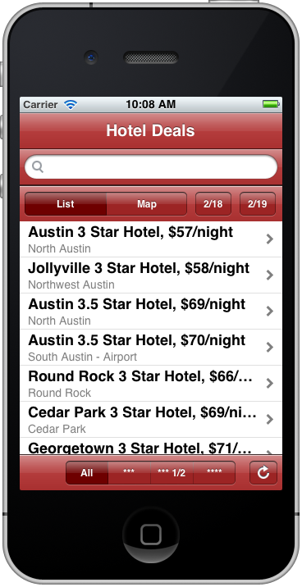
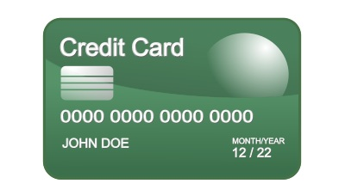


Multiple Use Cases: Credit Card Company
Fraud detection
Personalized offers
Credit card transactions
Fraud model
Recommendation
table
Big Data Platform (MapR)
Fraud investigation tool
Queries on IT logs
Fraud investigator
MapR: Single Platform

Slide 50
Apache SOLR and Lucene

Slide 52
Solr – Synthetic Fields

